Slide 1
Inverse Transforms and Derivatives
See p. 282 for some inverse transforms

Slide 2
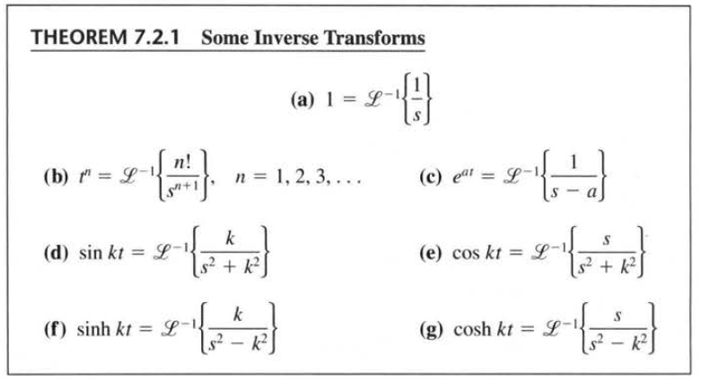
Ex. Find

Slide 3
Ex. Find

Slide 4
Ex. Find

Slide 5
Ex. Find

Slide 6
Ex. Find

Slide 7
Ex. Find

Slide 8
In general,
→ We can use this to solve an IVP

Slide 9
Ex. Solve y + 3y = 13sin 2t, y(0) = 6.

Slide 10
Ex. Solve y – 3y + 2y = e^{-4t}, y(0) = 1, y(0) = 5.

Slide 11
We had other methods to solve both of these problems, but note that the initial values and non-homogeneous parts are built in…
→ No worrying about cases, solving for constants, y_{c} and y_{p}, or variation of parameters.

