Slide 1
Warm-up Problems
Determine if the DE has a unique solution on the interval [0,5].
San Diego has a population of 3 million people, and the rate of change of this population is proportional to the square root of the population. Express this as an IVP.

Slide 2
Sketching Solution Curves
Ex.
While we can’t find a solution yet, we can find the slope of the solution at (0,2), assuming it passes through this point.
We can draw a segment through the point that has the appropriate slope: called a lineal element.
If we draw several of these lines, we get a good idea of what a solution would look like. This is called a slope field or direction field.

Slide 3
Ex. Draw a slope field for .
Sketch some solution curves.

Slide 4
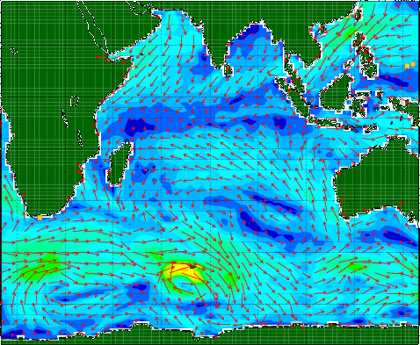

Slide 5
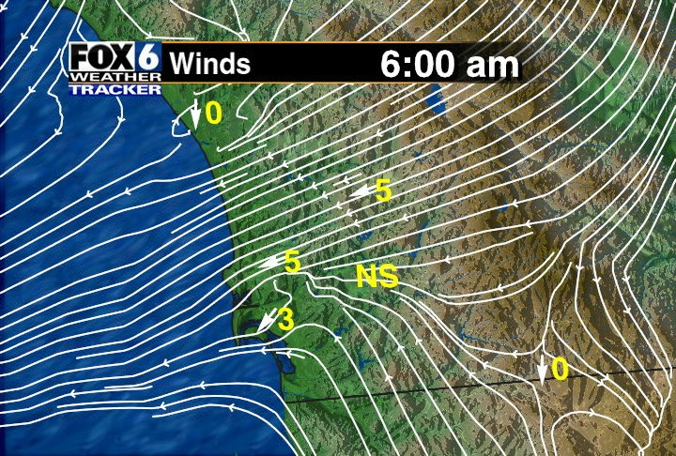

Slide 6
A shortcut would be to find all points that have the same slope
i.e. For the DE , find all points that cause f (x,y) = c for some constant.
→This is called the method of isoclines, and f (x,y) = c is called an isocline.

Slide 7
Ex. Sketch the isoclines for the DE for integer values of c, -5 ≤ c ≤ 5.

Slide 8
Def. A DE is autonomous if the independent variable does not appear.

Slide 9
We say that y = c is a critical point of the DE if f (c) = 0.
This is also called an equilibrium point or stationary point.
The constant function y = c is a solution to the DE, called the equilibrium solution.

Slide 10
Notice that the critical point divides the plane into regions where a solution will be monotonic (either increases or decreases).
Solutions can’t cross these horizontal lines, which serve as asymptotes of the solutions.
A phase portrait of an autonomous DE is a vertical number line that shows the increasing/decreasing nature of solution curves.

Slide 11
Ex. Sketch a phase portrait of , and then sketch typical solution curves in the regions in the xy-plane determined by the graphs of the equalibrium solutions.

Slide 12
Stable crit. pt.
Attractor
Unstable crit. pt.
Repeller
Semistable

Slide 13
Note: An autonomous DE such as depends only on the y-coordinate of the point. When sketching slope fields, all lineal elements along a horizontal line will have the same slope, since the slope is independent of x.
If the DE had been , all lineal elements along a vertical line would be parallel.

